Slide 1

Detection of COVID-19 on X-Ray image datasets using Deep Learning
Mini Project 1
Under the supervision of: Dr. Anupam Agarwal

Slide 2
Group Members
Priyanshu- IIT2019196
Rahul - IIT2020244
Chaudhari Yogiraj Prakash - IIT2020254
Mohd Wasif - IIT2020227
Palen Pushkar - IIT2017042

Slide 3
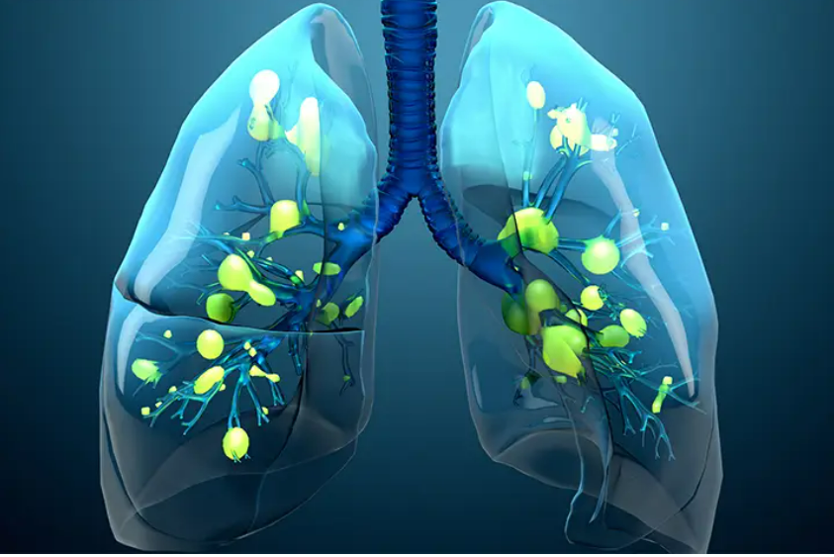
Introduction
The COVID-19 pandemic is very lamentable and has spread across the world.
The virus normally attacks the lungs in the human body and causes pneumonia in severe cases. Subsequently, it decreases the oxygen level instantly.
Among other approaches, artificial intelligence (AI) has been adapted to address the challenges caused by the pandemic.

Slide 4
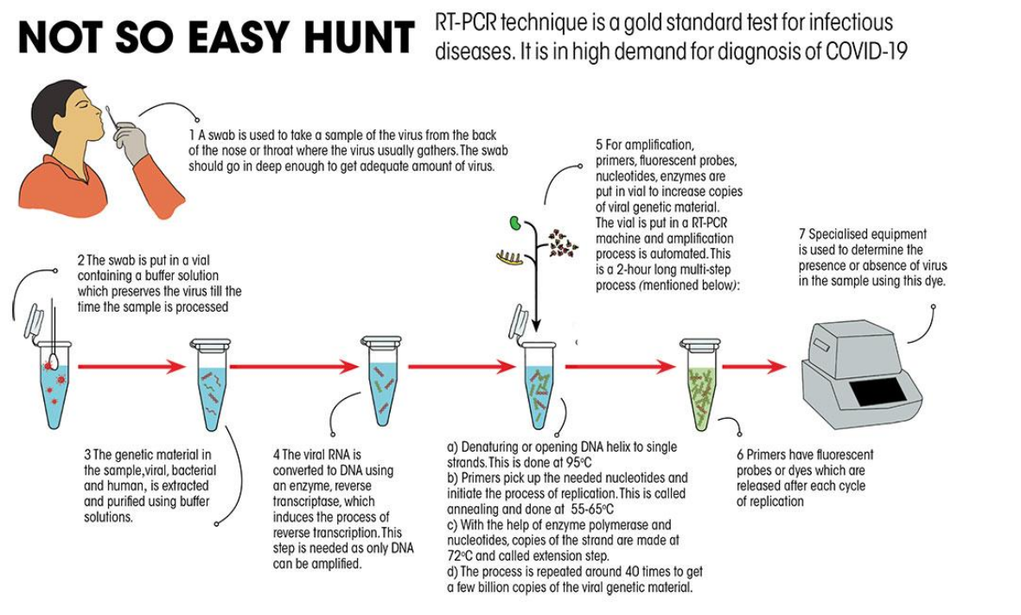
Normally, the polymerase chain reaction (PCR) test is widely used in medical science for testing.
However, because the number of cases is increasing rapidly, it has become nearly impossible to perform enough tests through PCR, as it is time-consuming and costly.
Therefore, an alternative testing is required so that infected people can be identified quickly and quarantined or isolated.

Slide 5
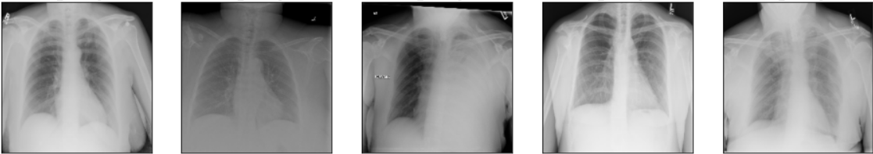
Problem Statement
The primary objective of the project is to predict and detect Covid-19 on Chest X-Ray images using deep learning approaches. This is a two-class classification problem where the input will be an X-Ray image and the output could be either Normal or COVID positive.

Slide 6
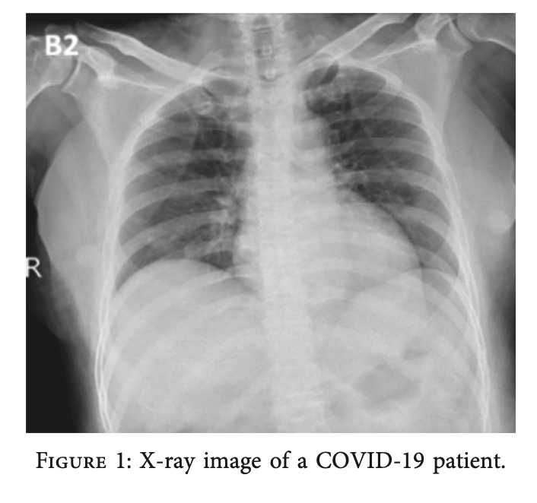
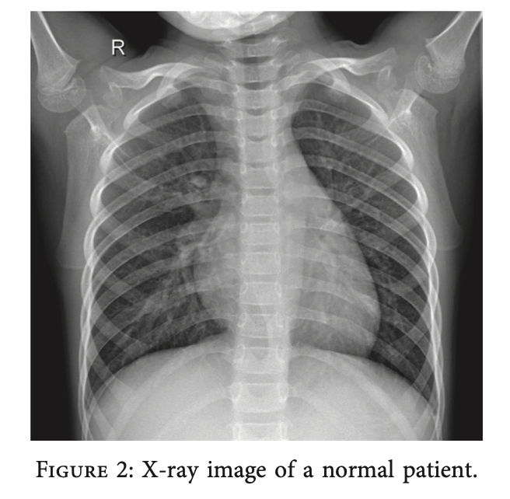
The following image shows how the chest X-Ray image of a COVID infected patient differs from the chest X-Ray of a normal healthy person:-

Slide 7
Literature Review
We have reviewed, implemented and tried to improve research papers based on multiple Deep Learning Approaches for COVID detection. Some of them are as follows:-
Transfer Learning approach (using pre-existing models like VGG, Inception)
Using Residual Networks with segmentation (on COVID-19 Radiography Database)
Using a modified DarkCovidNet
STM-RENet approach with Channel Boosting

Slide 8
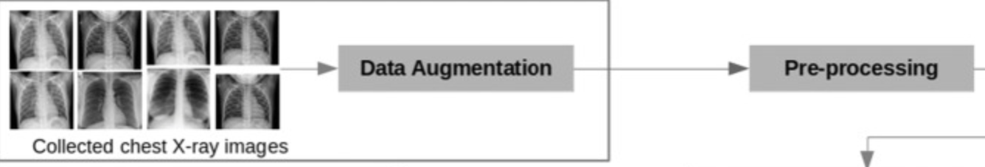
Paper Title(1):- Deep learning based detection of COVID-19 from chest X-ray images Authors: Sarra Guefrechi, Marwa Ben Jabra, Adel Ammar, Anis Koubaa and Habib Hamam
Summary of Paper(1):-
In this paper we used transfer learning on pre-trained models for VGG16 using the weights for ImageNet dataset.
This way, we can freeze all the trainable layers and just fine tune the last layer for COVID detection.

Slide 9
Advantages of Paper(1):-
The main advantage is that it gave a high recall score for a very low data size.
Disadvantages of Paper(1):-
Dataset size is very small (625) and hence there are higher chances of getting false positives.
What we improved:-
We apply data augmentation in order to build a converted version of the COVID-19 image (e.g., flip, small rotation, small distortion, etc.) to triple the set of samples.
We fine-tuned the last layer of the model, thus, we can use less labeled samples per category for the training process.

Slide 10
Paper Title(2):-An Efficient Deep Learning Model to Detect COVID-19 Using Chest X-ray Images Authors: Somenath Chakraborty, Beddhu Murali, and Amal K. Mitra
Summary of Paper(2):-
In this paper, they used the ResNet50 model which introduces the concept of skip connection in the deep layers which helps to solve the problem of vanishing gradient.
The dataset used is the COVID-19 Radiography Dataset downloaded from Kaggle which had around 20,000 images for COVID and non-COVID based pneumonia and healthy cases.
The basic idea behind the working of this model is that COVID-19 positive is characterized primarily by patches of ground-glass opacity and consolidations in the lungs.

Slide 11
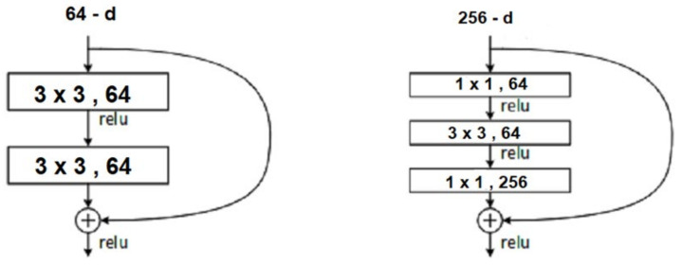
The best part about this model is that during the data preprocessing stage of the model, the X-Ray images undergo segmentation to get the lung contours. So, the downloaded X-Ray images from Kaggle consisted of many unwanted regions outside the lung contour. This helps our Model to accurately learn the actual infected area but also makes the model more robust while ignoring the unnecessary regions of the chest. Advantages of Paper(2):-
The number of X-Ray images in this paper was quite large to accurately measure the model performances. The performance indicators such as accuracy, sensitivity, specificity, and F1 scores of the study model were higher than the transfer learning approach.

Slide 12
Limitations of Paper(2):-
The model failed to distinguish between normal pneumonia and COVID infection. Also, the Kaggle COVID Radiography Dataset is highly imbalanced.
What we improved:-
We added the visualizations to the model in the form of Class Activation maps. The class activation map gives us an idea of why a particular X-Ray sample is COVID positive and also gives information about the infected region in the lungs. This GRAD-CAM function returns the heat map, which later is mapped on the input with which we can determine which area in chest has COVID-19.

Slide 13
Paper Title(3):-Automated detection of COVID-19 cases using deep neural networks with X-ray images Authors: Tulin Ozturk, Muhammed Talo, Eylul Azra Yildirim, Ulas Baran Baloglu, Ozal Yildirim and U. Rajendra Acharya
Summary of Paper(3):-
This model is a modification of the popular DarkNet classification model which is based on YOLO.
The proposed model has 17 convolution layers (same as DarkNet).
Datasets have been taken from from Cohen J.P. Kaggle dataset. Eighty percent of X-ray images are used for training and 20% for validation.

Slide 14
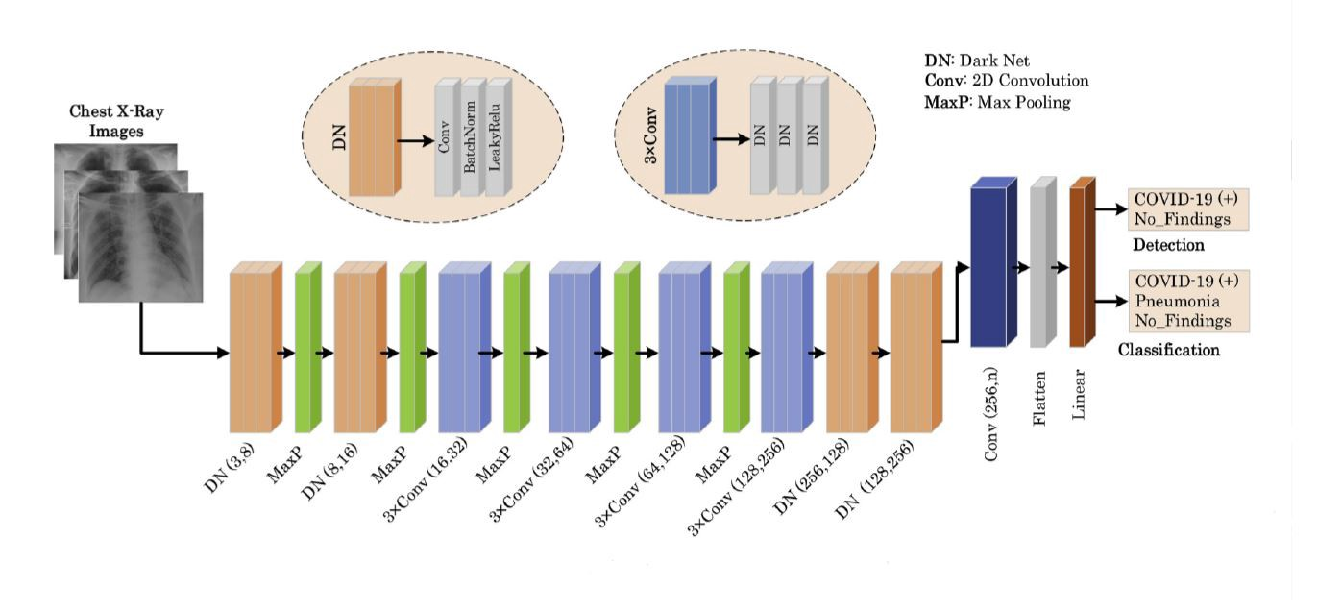
Advantages of Paper(3):-
The model is sensitive in detecting pneumonia disease from COVID infection.
They did a radiological analysis on their model with the help of an expert radiologist. With this they could easily distinguish between various signs like Ground-glass opacities, central distribution, unilateral and Reticular opacity or Bronchial wall thickening
Drawbacks of Paper(3):-
The model made the incorrect predictions in poor quality X-ray imagery and in patients with acute respiratory distress syndrome, in which the lung image is diffuse and much lung ventilation is lost.

Slide 15
Paper Title(4):-COVID-19 Detection in Chest X-ray Images Using a New Channel Boosted CNN Authors: Saddam Hussain Khan, Anabia Sohail, Asifullah Khan and Yeon-Soo Lee
Summary of Paper(4):-
A major problem with all the previous implementations, be it VGG model, or ResNet or even DarkNet is that these models have been employed on the imbalanced dataset and reported their accuracy and sensitivity results, which are not considered appropriate for imbalanced data.
The proposed STM-RENet is a block-based CNN that employs the idea of split–transform–merge in a new way. In this regard, they have proposed a new convolutional block STM that implements the region and edge-based operations separately.

Slide 16
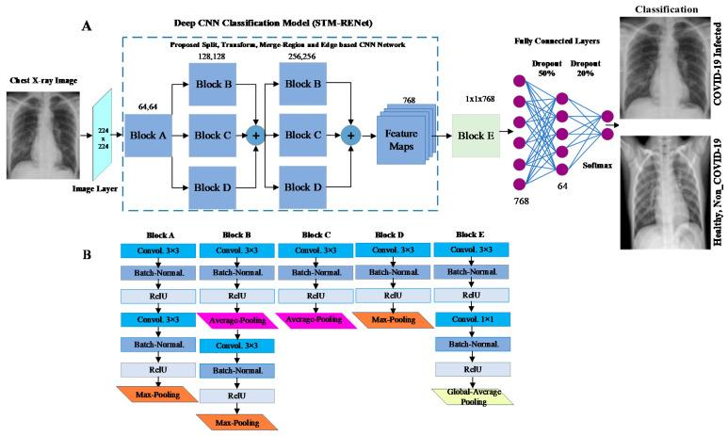
The systematic use of region and edge implementations in combination with convolutional operations helps in exploring region homogeneity, intensity inhomogeneity, and boundary-defining features.
The learning capacity of STM-RENet is further enhanced by developing a new CB-STM-RENet that exploits channel boosting and learns textural variations to effectively screen the X-ray images of COVID-19 infection. The idea of channel boosting is exploited by generating auxiliary channels from the two additional CNNs using Transfer Learning, which are then concatenated to the original channels of the proposed STM-RENet.

Slide 17
The region operation helps learn about the infectious regions’ characteristics by highlighting textural and intensity variations. In addition, edge operation demarcates infected areas and identify lung markings in both healthy and COVID-19 infected X-ray images.
Three different datasets from the publicly available chest X-ray images are generated (CoV-Healthy-6k, CoV-NonCoV-10k, and CoV-NonCoV-15k). These are highly balanced datasets.
The dataset was divided into train and test sets at a ratio of 8:2. From the training dataset, 20% was reserved for model validation.
If trained on the correct dataset, this model can achieve very high accuracy crossing 99%.

Slide 18
Methodology
We start by implementing a Transfer Learning based approach. Due to the insufficient number of free COVID-19 radiography images, it is not possible to develop a CNN model from scratch to automatically identify COVID-19 from X-ray images. In order to control this problem, we adopt a famous method called “transfer learning” and fine-tune three well-known pre-trained models on the prepared data set.
Using this approach, we got an accuracy of around 96.77% on a data size of about 600 images. A major disadvantage of using the Transfer Learning approach is that there are high chances of False Negatives and low data sizes cause overfitting over higher parameters.

Slide 19
So we then implement another model which is based on ResNet50 using Lung Contours and GRAD-CAM. This method too could only achieve an accuracy of 97.33%. This too wasn’t enough.
Then we implemented a modification of the popular DarkNet model called DarkCovidNet. It is a YOLO based multi-class classification approach and we could achieve an accuracy of about 98.08%.
We needed further improvement in detecting False Negatives and thus for our final implementation, we approached a channel boosting method on the existing STM-RENet method.
Using this method, we achieved an accuracy of around 99%. This way, we were able to approach the challenge of COVID detection with high accuracy.

Slide 20
Languages/tools used
Language to be used : Python, MATLAB Environment : PyCharm and Anaconda, Jupyter Notebook, MATLAB
Libraries to be Used :
Pandas - Data Pre-processing
Numpy - Mathematical tools
Matplotlib - Plotting Maps
Keras - Deep Learning Models
SkLearn - Machine Learning Algorithms
Itertools - Data Structures
cv2 - Image Processing
Fastai
PyTorch

Slide 21
Implementation

Slide 22
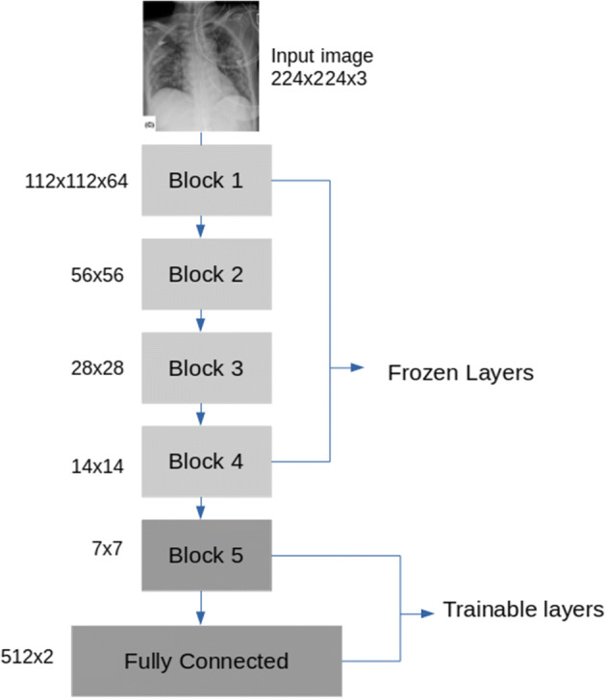
(i) Implementation using Transfer Learning
Here we are going to use Transfer Learning with advanced and popular architectures like VGG-16, InceptionV2, ResNet with pre-trained weights on our image dataset. Then adapt it to our dataset. So, it will be our base Model.
The dataset will be obtained from the different sources some of which are live active medical datasets on various repositories while some are from Kaggle. For testing, we will use a publicly available Kaggle dataset called ChestX-ray8 which consists of a total of 625 images

Slide 23
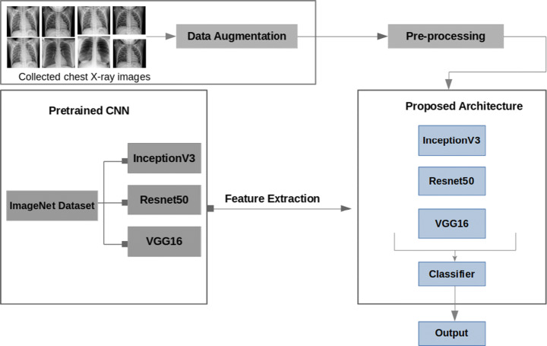
We will be using a sequential method as we are creating a sequential model. Sequential model means that all the layers of the model will be arranged in sequence, then we will add:
AveragePooling2 layer of 4x4 pool size
Fully Connected : 1 x Flatten : 1 x Dense of 64 units 1 x Dropout set at 50% 1 x Dense of Softmax layer of 2 units

Slide 24
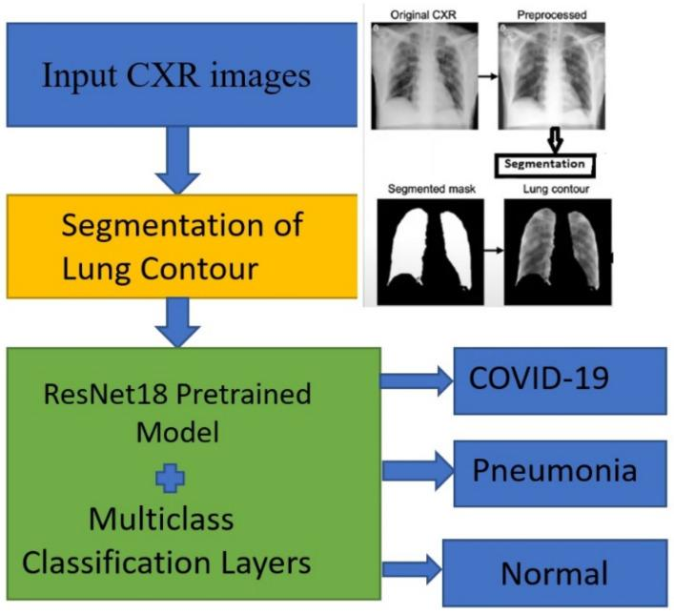
(ii) Implementation using Residual Networks
In this method, we used a ResNet to detect COVID-19 using chest X-ray (CXR) images. Radiographic images are readily available and can be used effectively for COVID-19 detection compared to other expensive and time-consuming pathological tests. We used a dataset of 10,040 samples, of which 2143 had COVID-19, 3674 had pneumonia (but not COVID-19), and 4223 were normal (not COVID-19 or pneumonia).

Slide 25
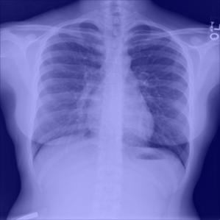
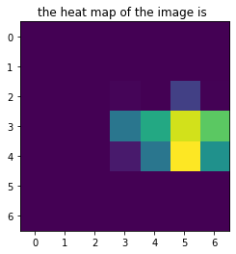
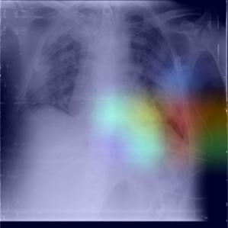
The following figures show how our ResNet50 model is modified to give a heatmap of lungs which gives us an idea of the region of impact of COVID-19.

Slide 26
(iii) Implementation using DarkCovidNet
We have used the Darknet-19 model as the base model of this implementation. Darknet-19 is the classifier model that forms the basis of a real-time object detection system named YOLO (You only look once).
The Darknet-19 model has proven to be the state-of-the-art model in object detection technique. The proposed architecture consists of 17 convolutional layers. The architecture diagram is given below.
Each DN (DarkNet) layer has one convolution layer followed by BatchNorm and LeakyReLU operations. The 3 x Conv layer has the same setup three times in successive form.

Slide 27
The DarkCovidNet deep learning model consists of 1,164,434 parameters. We have used Adam optimizer for weight updates, cross-entropy loss function, and selected the learning rate as 3e-3

Slide 28
(iv) Implementation using STM-RENet
This implementation was a new technique based on CB CNN for automated detection of COVID-19 from chest X-Ray images. The technique targets the discrimination of COVID-19 infected from both non-COVID-19 infected and Healthy individual.
In this regard, a new CNN classifier based on novel split-transform-merge (STM) block was developed that systematically implements RE-based operations for the learning of COVID-19 specific patterns and termed as “STM-RENet”.
The learning capacity of the proposed CNN is enhanced using Channel Boosting to improve the detection rate while maintaining high precision.

Slide 29
Three different Chest X-Ray images datasets were used.
CoV-Healthy-6k
CoV-NonCoV-10k
CoV-NonCoV-15k

Slide 30
Results and Comparison

Slide 31
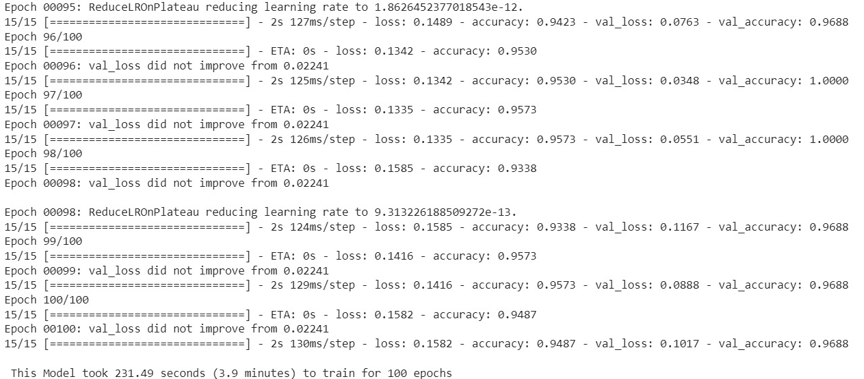
In the transfer learning approach for VGG-16, we train the fine tuned model for 100 epochs.
While testing, we pick 16 images in a batch and we get the following output:-

Slide 32
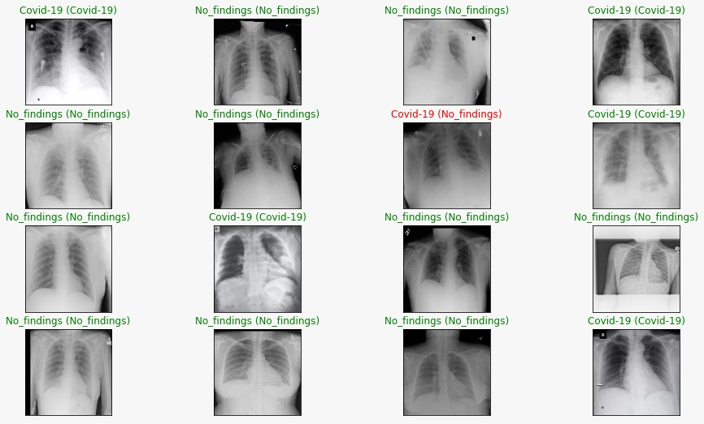
This result shows one falsely predicted result out of 16 generated results. Most of the results were correctly predicted by our model. The following graphs were obtained for the loss and accuracy by our model:-

Slide 33
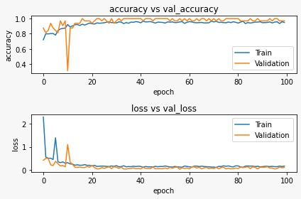
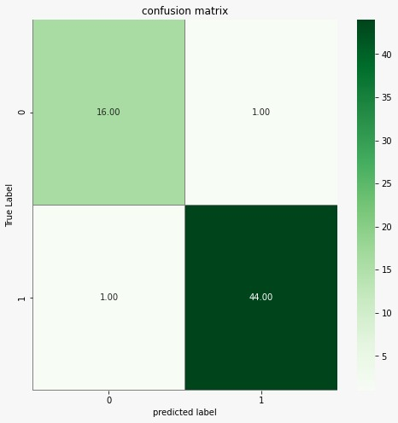
From the Training and Validation accuracy graph above, our model does not seem to be overfitted, which is great. Our Training and Validation Loss graph above also indicates a good learning rate, which is amazing.
The following confusion matrix was obtained by our model:-

Slide 34
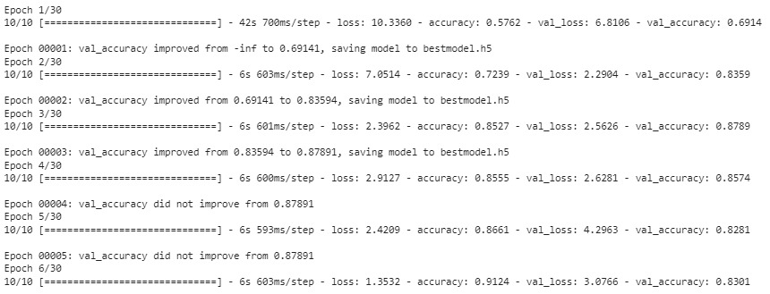
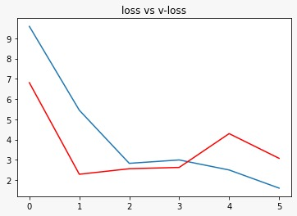
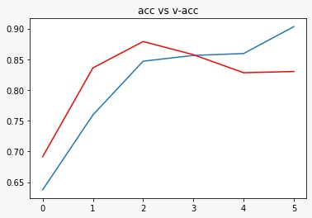
In the ResNet50 approach, we ran the model for around 30 epochs and obtained the following graphs for accuracy and loss:- This implementation also included a GRADCAM. This grad-cam function returns the heat map, which later is mapped on the input X-Ray, with this we can determine which area in the chest has COVID-19.

Slide 35
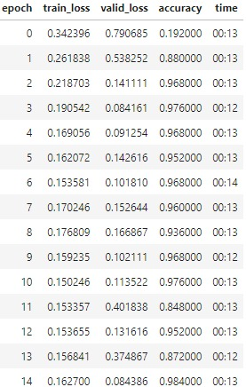
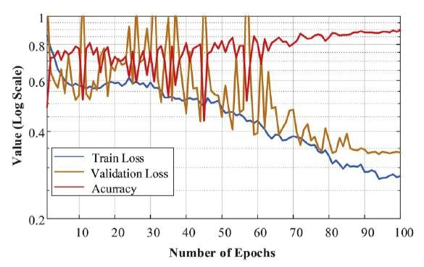
For the implementation of DarkCovidNet, we ran the model up to 100 epochs.
After training we obtain the following variations for accuracy and loss with the number of epochs:

Slide 36
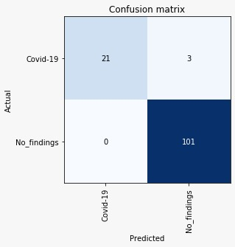
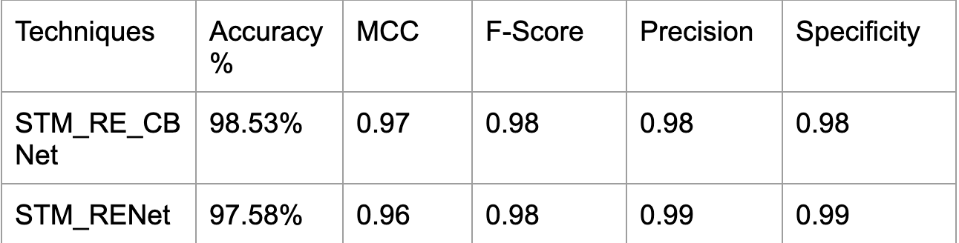
The following confusion matrix was obtained as a result:
For the channel boosted STM-RENet we obtained the highest accuracy of around 99%. The other evaluation parameters are summarized in tabular form below:

Slide 37
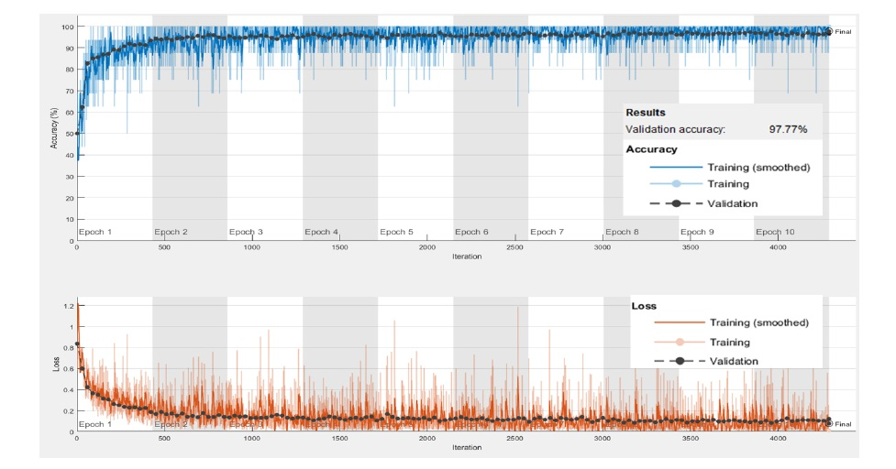
The accuracy and loss plots against the number of epochs were also plotted. This curve shows that the model achieves optimal accuracy in just a few epochs and then stays constant pretty much.

Slide 38
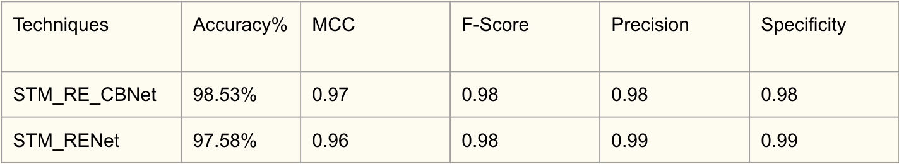
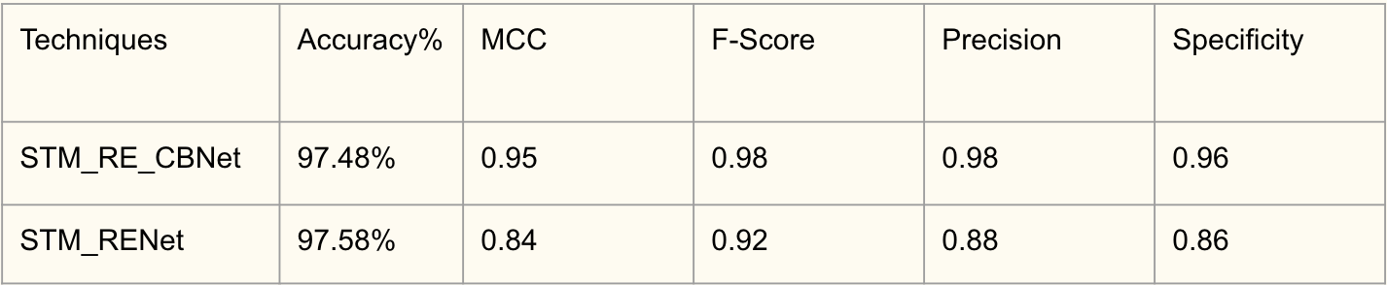
A comparison analysis of the various methods we implemented is given below:-
This graph shows the comparison between performances of Channel boosted STM and non Channel Boosted STM with two different datasets.

Slide 39
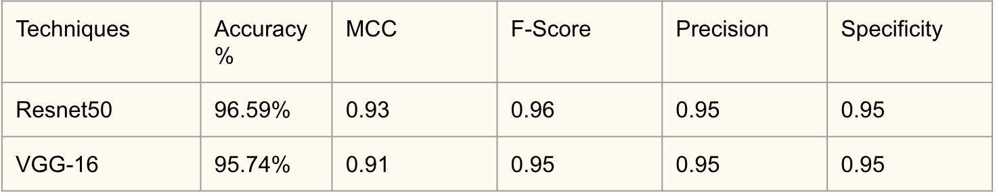
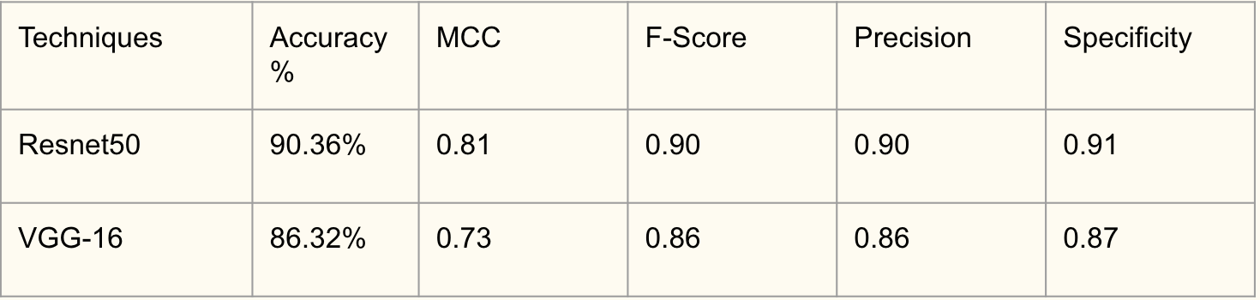
The following tables show a comparison between ResNet50 and VGG-16 (transfer learning) when tested on the Cov-NonCoV10k dataset.

Slide 40
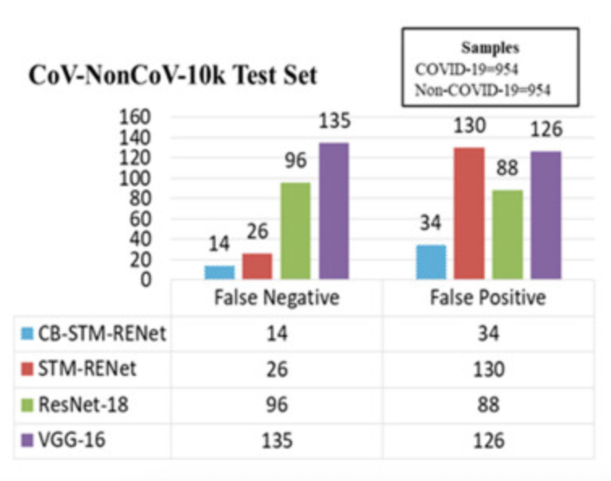
Comparison between all models:
The following graph shows the comparison of false positives and false negatives of all the models we implemented. This shows that while VGG-16 with transfer learning gave the lowest performance, the channel boosted STM-RENet gave the highest performance and hence the lowest number of false positives and false negatives.

Slide 41
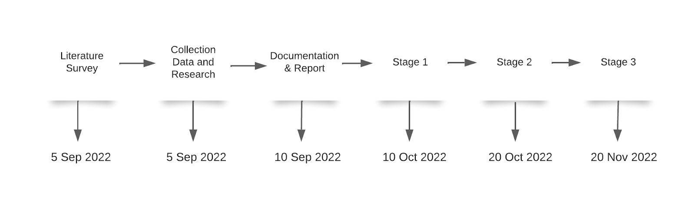
Activity Time Chart

Slide 42
Conclusion and Future Scope
The encouraging results of the deep learning models that we implemented for detecting COVID-19 in X-Ray image detection indicates that in the near future, deep learning will play a greater clinical support role for fighting against this epidemic.
In the future, the proposed CB-STM-RENet will be exploited for the multi-class segregation of COVID-like MERS and SARS-CoV, etc., and to distinguish between various new variants of COVID-19, such as Omicron, etc.

Slide 43
References
[1] A. Uddin, B. Talukder, M. Monirujjaman Khan, and A. Zaguia, “Study on convolutional neural network to detect COVID-19 from chest X-rays,” Math. Probl. Eng., vol. 2021, pp. 1–11, 2021.
[2] R. Sethi, M. Mehrotra, and D. Sethi, “Deep Learning based Diagnosis Recommendation for COVID-19 using Chest X-Rays Images,” in 2020 Second International Conference on Inventive Research in Computing Applications (ICIRCA), 2020.
[3] L. Wang and A. Wong, “COVID-Net: A tailored deep convolutional neural network design for detection of COVID-19 cases from chest X-ray images,” arXiv [eess.IV], 2020.
[4] I. D. Apostolopoulos and T. A. Mpesiana, “Covid-19: automatic detection from X-ray images utilizing transfer learning with convolutional neural networks,” Phys Eng Sci Med, vol. 43, no. 2, pp. 635–640, 2020.

Slide 44
[5] S. Guefrechi, M. B. Jabra, A. Ammar, A. Koubaa, and H. Hamam, “Deep learning based detection of COVID-19 from chest X-ray images,” Multimed. Tools Appl., vol. 80, no. 21–23, pp. 31803–31820, 2021.
[6] S. Chakraborty, B. Murali, and A. K. Mitra, “An efficient deep learning model to detect COVID-19 using chest X-ray images,” Int. J. Environ. Res. Public Health, vol. 19, no. 4, p. 2013, 2022.
[7] T. Ozturk, M. Talo, E. A. Yildirim, U. B. Baloglu, O. Yildirim, and U. Rajendra Acharya, “Automated detection of COVID-19 cases using deep neural networks with X-ray images,” Comput. Biol. Med., vol. 121, no. 103792, p. 103792, 2020.
[8] S. H. Khan, A. Sohail, A. Khan, and Y.-S. Lee, “COVID-19 detection in chest X-ray images using a new channel boosted CNN,” Diagnostics (Basel), vol. 12, no. 2, p. 267, 2022.

Slide 45
Thank You!

